Slide 1
Prediction of Apple Stock Price
Using Social Consensus & Relevant Financial Info
Zhengyi Li
Weiyao Xie

Slide 2
General Goal
Use news data, exchange rate, relevant stock price to predict the trend of Apple stock price and the future Apple stock price.

Slide 3
Dataset & Preprocessing

Slide 4
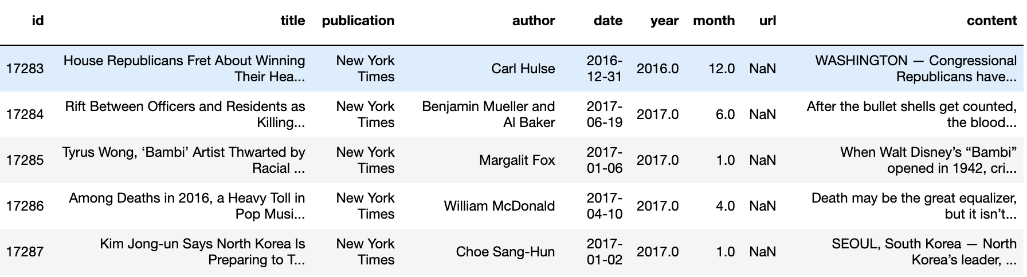
News Dataset
Download from Kaggle:https://www.kaggle.com/snapcrack/all-the-news#articles3.csv
News articles in different days

Slide 5
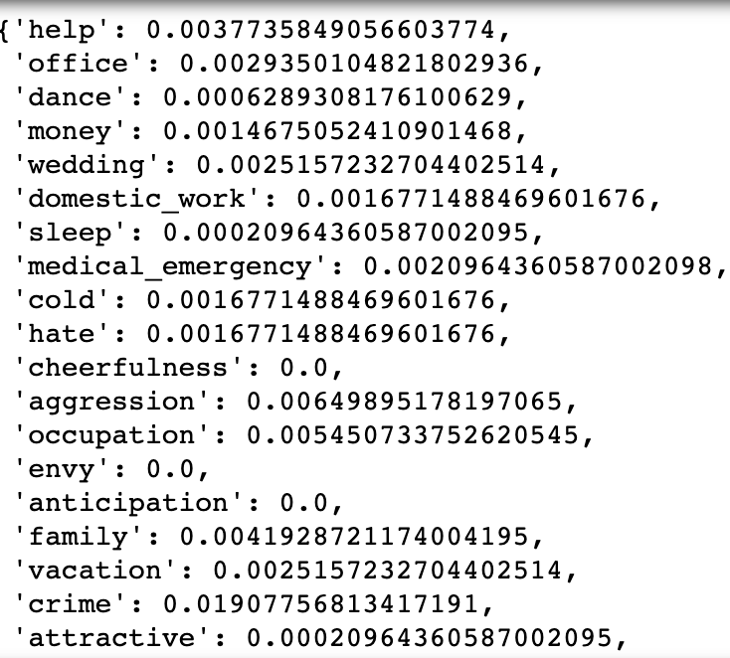
Empath Sentiment Analysis
Empath Sentiment
“Empath analyzes text across hundreds of topics and emotions. Like LIWC and other dictionary-based tools, it counts category terms in a text document. ”
As good as LIWC but cheaper
Eg.
“After the bullet shells get counted, the blood dries and the votive candles burn out, people peer down from windows and see crime scenes gone cold: a band of yellow...”

Slide 6
Sentiment Analysis
Empath sentiment analysis from:https://github.com/Ejhfast/empath-client
Parameters show relevance with Apple:
Negative Emotion:
Positive Emotion:

Slide 7
News emotion relevance features
Relevance = avg(sum(relevance with Apple))
Negative relevance = relevance * avg(sum(Negative emotions))
Positive relevance = relevance * avg(sum(Positive emotions))

Slide 8
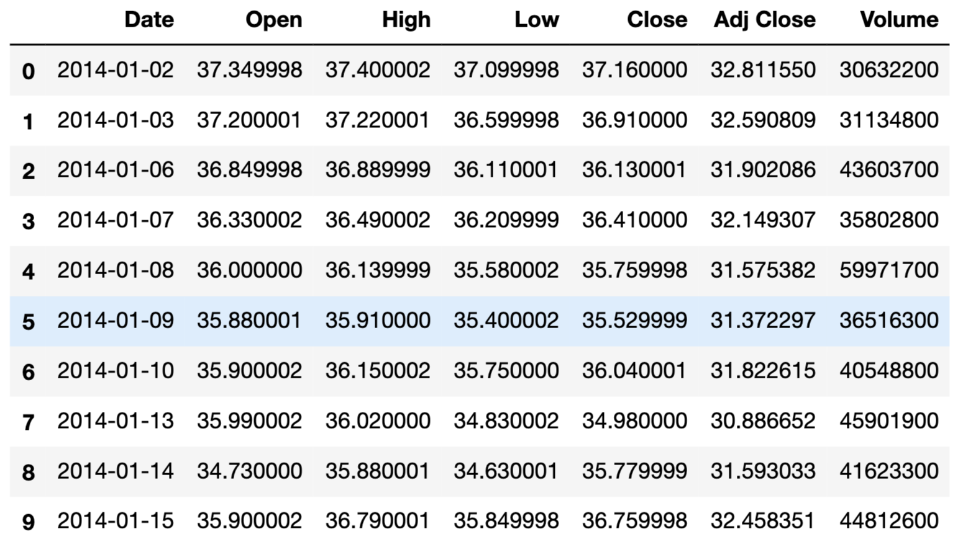
Relevant Stock
Qualcomm
Microsoft
Texas Instrument

Slide 9
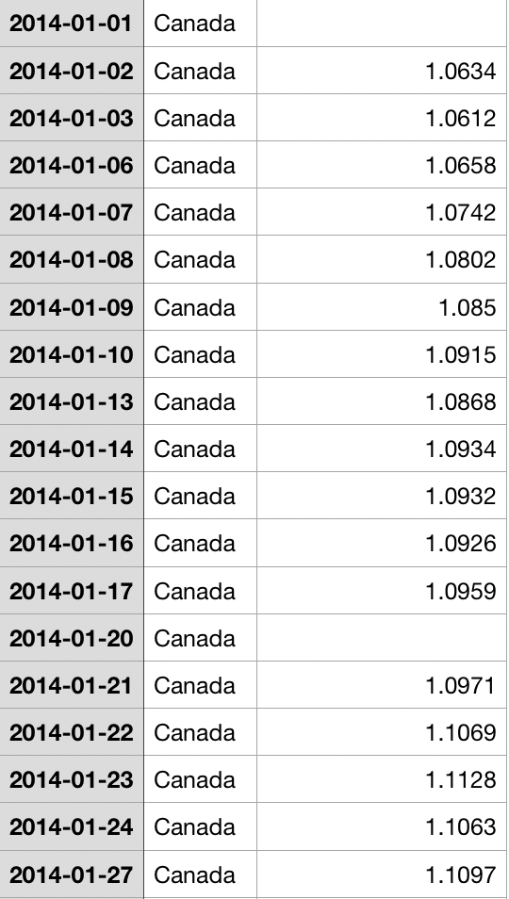
Exchange rate (to US dollar)
Hong Kong Dollar
Chinese Yuan
Canadian Dollar
Euro

Slide 10
Apple Stock Price
Two types of target value we want to predict:
Daily close price
Trend of the day = close price - open price

Slide 11
Processing Target Algo
Two situations
Days with stock price(Weekdays)
Pass the current news data to next day
Get the stored news data from last day
Days with no stock price(Weekends and Holidays)
Store the news data

Slide 12
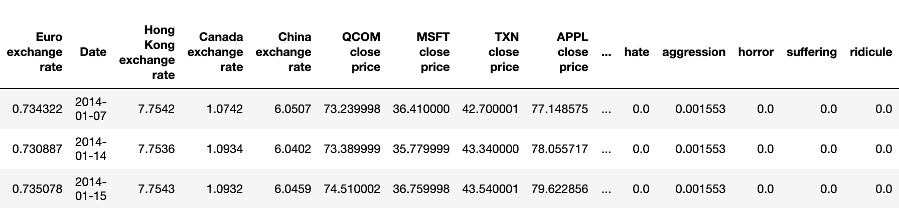
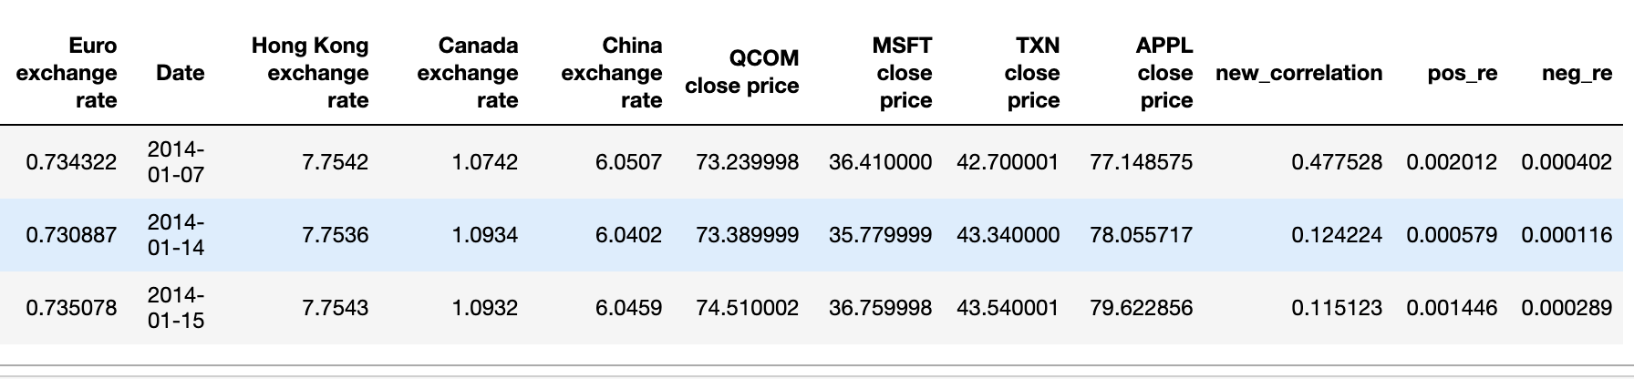
Processed Data (close price)
Dataset with all news parameters and close price of the Apple
Dataset with three news parameters and close price of the Apple

Slide 13
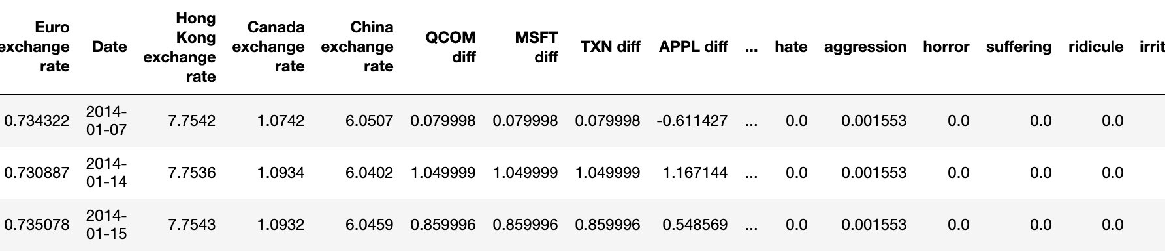
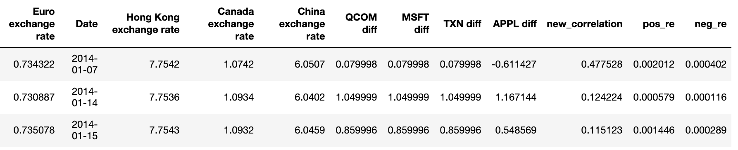
Processed Data(price difference)
Dataset with all news parameters and difference price of the Apple
Dataset with three news parameters and difference price of the Apple

Slide 14
Dataset size
Dataset with all news parameters and close price of the Apple have features of 38
Dataset with three news parameters and difference price of the Apple have features of 11
Total example size is 668

Slide 15
Linear Regression

Slide 16

Model Selection Eout for news emotion relevance
Ridge degree | 1 | 2 | 3 | 4 | 5
0 | 64.25 | 49.70 | 97.98 | 75.45 | 36.75
0.35 | 72.63 | 35.98 | 37.77 | 45.45 | 173.64
0.5 | 74.58 | 73.08 | 374.20 | 42.75 | 152.62
0.75 | 77.71 | 37.46 | 74.47 | 33.75 | 130.62

Slide 17
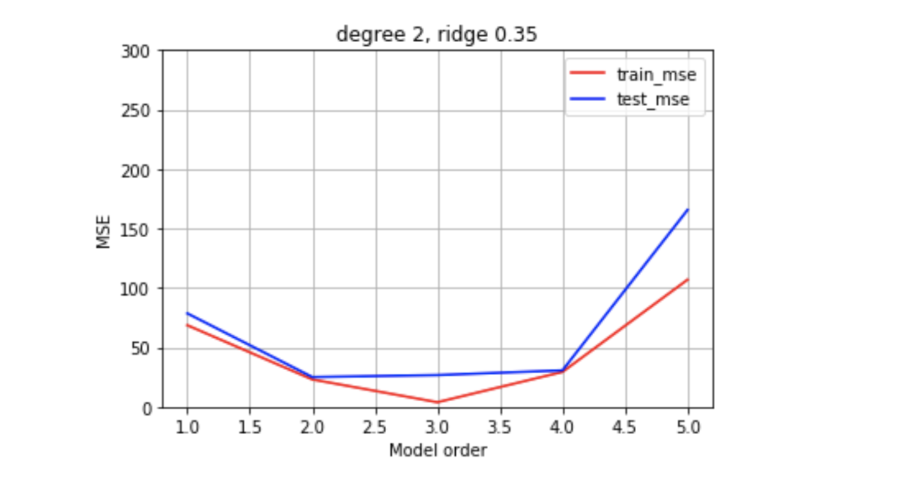

Model Selection for news emotion relevance

Slide 18
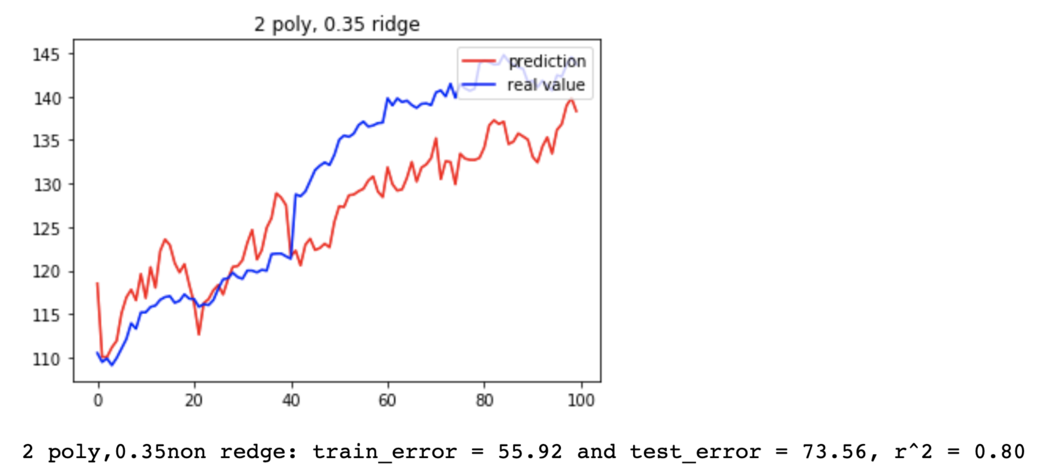
Market + news emotion relevance(plot 100 data)

Slide 19
Model Selection Eout for all features
Ridge degree | 1 | 2 | 3 | 4 | 5
0 | 59.44 | 88.49 | 273.06 | 346.24 | 8.63
0.35 | 83.53 | 577.57 | 310.62 | 346.24 | 8.63
0.5 | 85.49 | 47.31 | 231.26 | 346.24 | 8.63
0.75 | 75.49 | 37.78 | 197.15 | 23.53 | 47.92

Slide 20
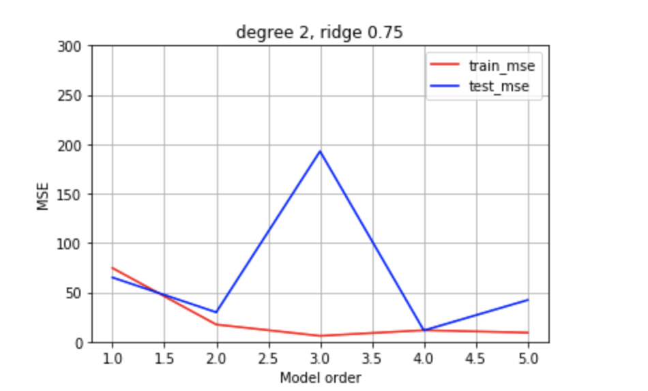
Model Selection for all features

Slide 21
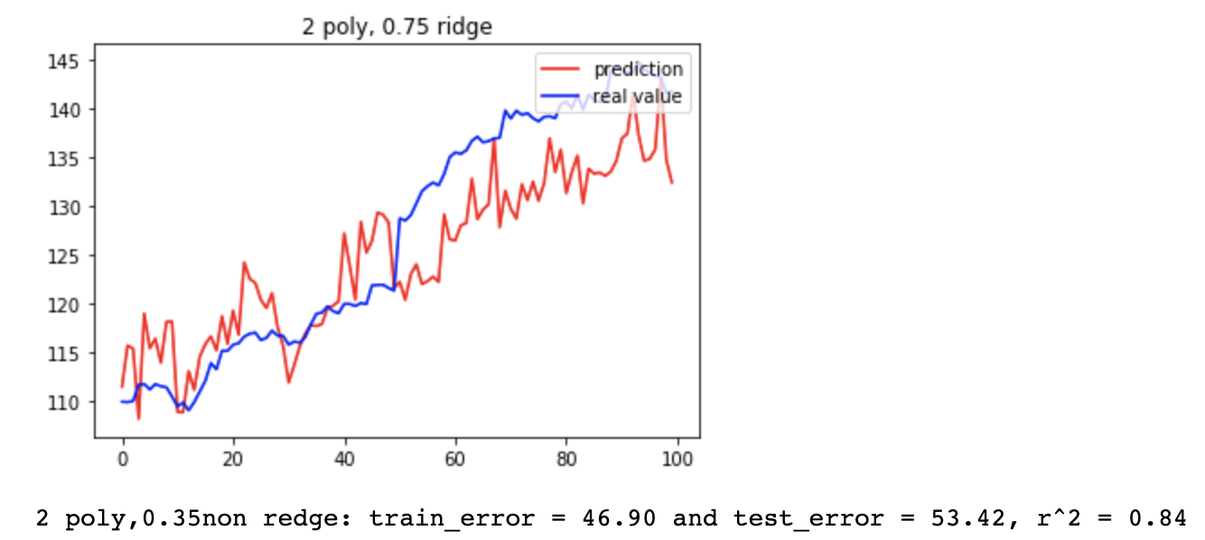
Market + All Features (plot 100 data)

Slide 22
SVM

Slide 23
Dataset
Choose of the dataset
Target is the difference of close price and close price
Change the target value
Transfer the difference into 1 or -1

Slide 24
Three Kernels with and without PCA
Linear Kernel
RBF Kernel
Polynomial Kernel

Slide 25
Training and testing accuracy
Calculate the percentage of number of Correct prediction / Total number of prediction

Slide 26
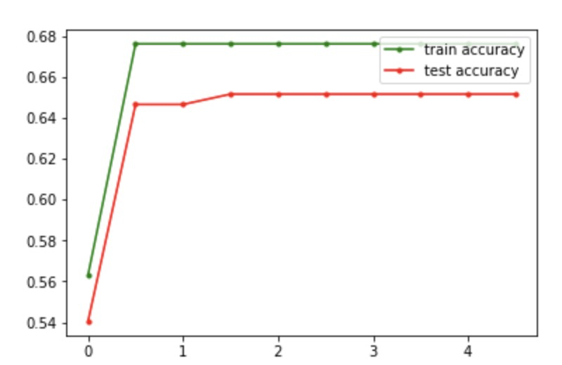
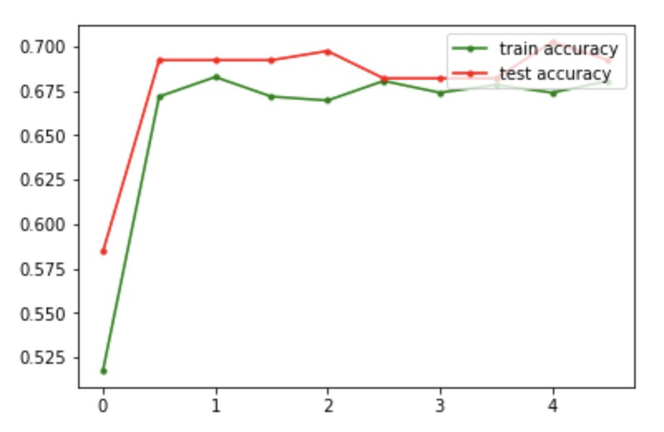
Linear Kernel without PCA
News emotion relevance
All features

Slide 27
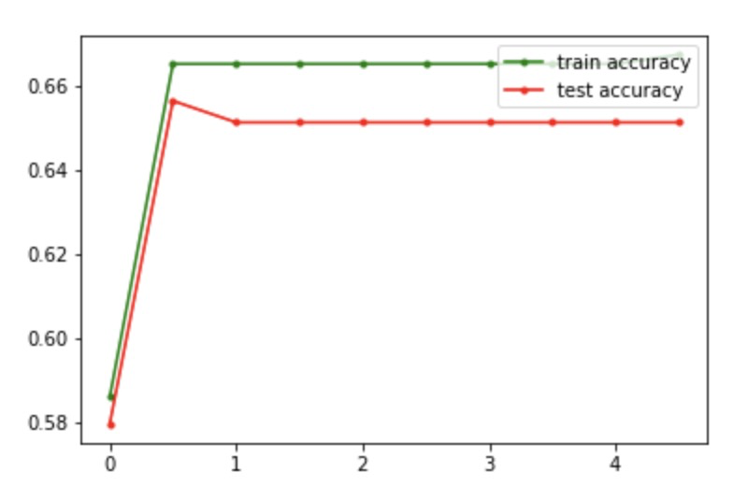
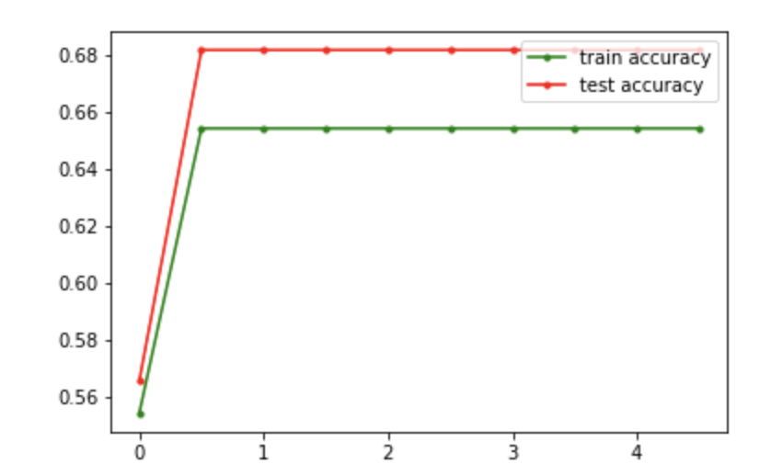
Linear Kernel with PCA
News emotion relevance
All variables

Slide 28
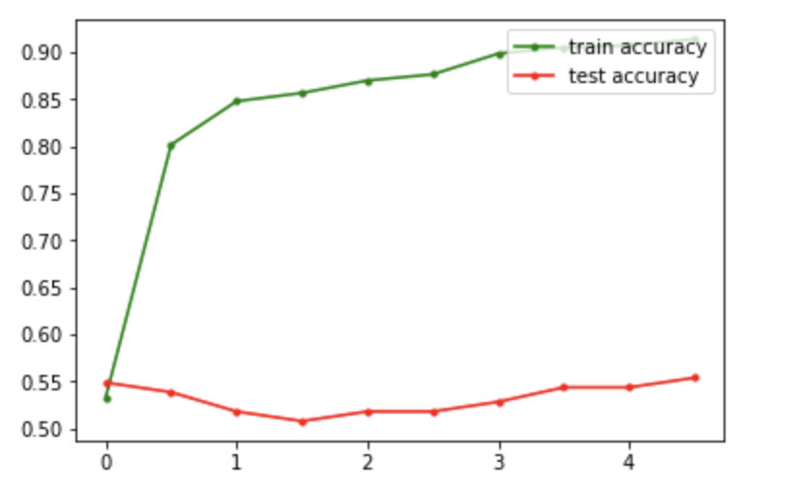
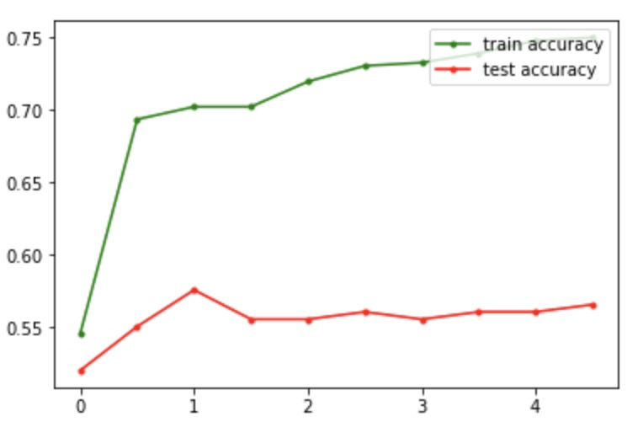
RBF kernel without PCA
News emotion relevance
All features

Slide 29
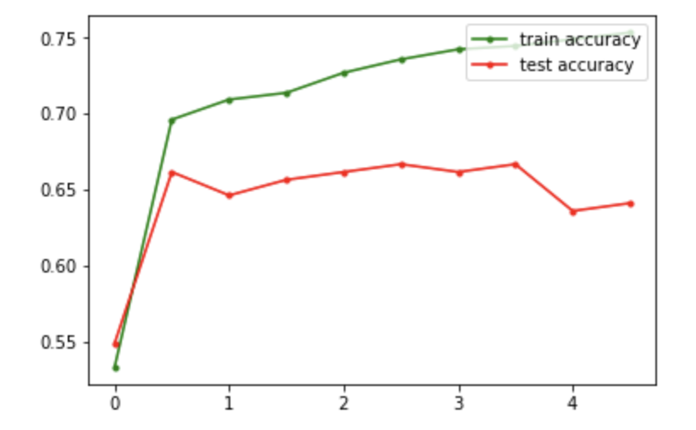
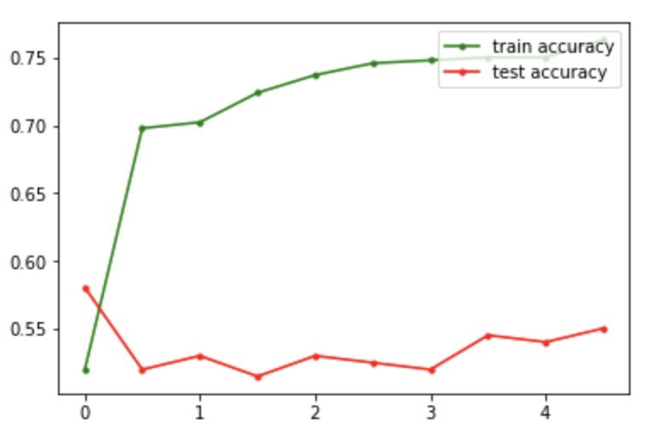
RBF Kernel with PCA
News emotion relevance
All features

Slide 30
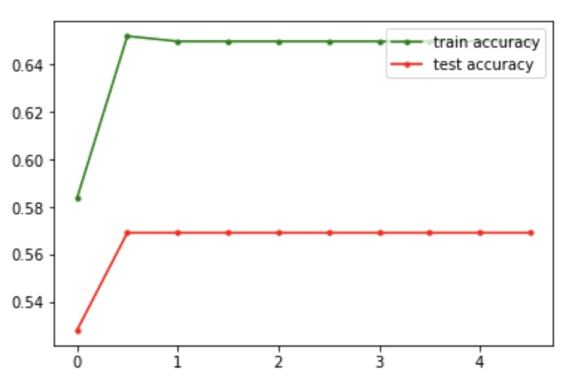
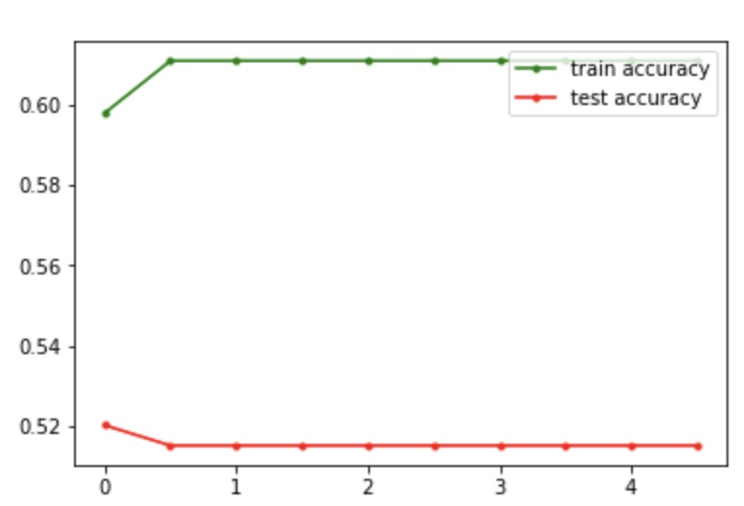
Polynomial Kernel with PCA
News emotion relevance
All features

Slide 31
Best Model
Linear Kernel without PCA for news emotion relevance
C = 0.501
Accuracy of Test= 0.656410
Linear Kernel without PCA for all features
C = 1
Accuracy of Test= 0.702

Slide 32
Neural Network

Slide 33
Dataset and Library
Choose of the dataset
Target is the difference of close price and close price
Change the target value
Transfer the difference into 1 or 0
Keras:
keras.metrics.binary_accuracy(y_true, y_pred)

Slide 34
NN models parameters
Hidden Layer :
hidden layer as list. eg [10,4,2] is three hidden layer with 10 neurons in first hidden layer, 4 neurons in second layer, and 2 neurons in last layer etc.
Activation function:
activation function. eg. elu, relu, sigmoid, hard_sigmoid, exponential, linear
Activity regularizer:
we want regularize the value after calculating the activation function
Optimizer:
optimize function that used to update the parameters each generation. eg. SGD, RMSprop, Adagrad, Adadelta
Batch size:
number of samples per gradient update.
Epochs:
number iterations of generation update

Slide 35
Active Functions & Optimizer
Active Functions
Sigmoid
relu
Optimizer
SGD
RMSprop:
Divide the gradient by a running average of its recent magnitude

Slide 36
Batch size & Epochs
For all different Active Functions and Optimizers combinations, we run 24 models with different batch size and epoches.
Batch size
From 30 to 600, increasing 100 each time
Epochs
From 1000 to 10000, increasing 3000 each time

Slide 37
Limitation
Layers
One hidden layer with 15 neurons for all news features dataset
One hidden layer with 6 neurons for news emotion relevance features dataset
Activity regularizer rate
0.001

Slide 38
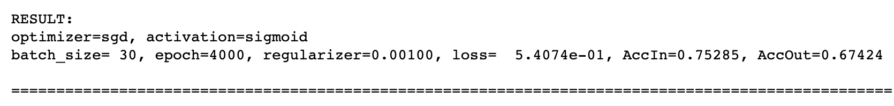
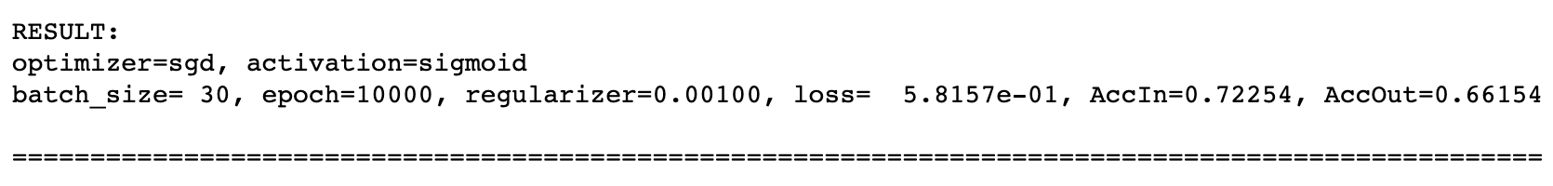
Result: Sigmod & SGD
Dataset using all news features
Dataset using three news emotion relevance features

Slide 39
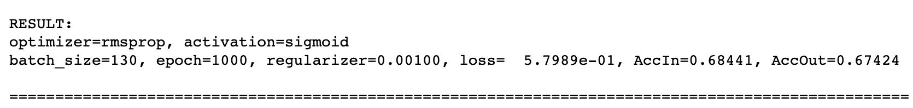
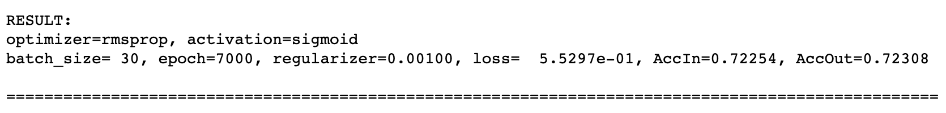
Result: Sigmod & RMSprop
Dataset using all news features
Dataset using three news emotion relevance features

Slide 40
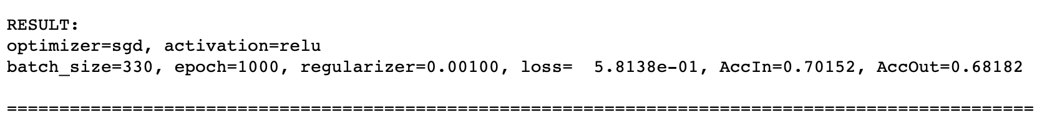
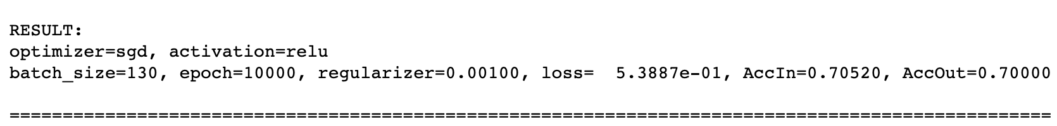
Result: Relu & SGD
Dataset using all news features
Dataset using three news emotion relevance features

Slide 41
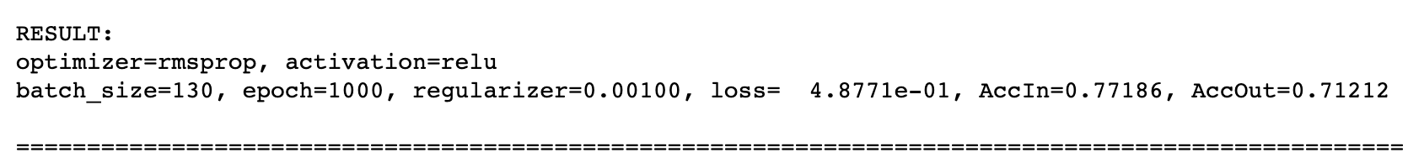
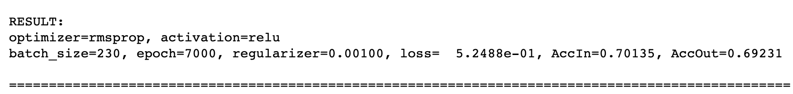
Result: Relu & RMSprop
Dataset using all news features
Dataset using three news emotion relevance features

Slide 42
Select the Model
Best model for Dataset using all news features
Best model Dataset using three news emotion relevance features

Slide 43
Regulzer & Hidden Layer
Regularizer
[0.00001,
0.0001,
0.001,
0.01,
0.1,
0.5,
0.75]
Hidden Layer
For all news features
15 neurons first layer
8 neurons second layer
For news emotion relevances
6 neurons first layer
3 neurons second layer
Now fix the active function and optimizer for two datasets
Change regularizer and layers
However, the result is not good as original models
Reason of Layers
Reason of Regularizer

Slide 44
Result
Regression:
Classification

Slide 45
Potential Problem
Dataset problem
news
Number of years
More situation to consider
Days off

